Slide 1

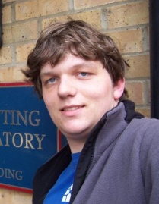

Stability, Information and Generalization
in Adaptive Data Analysis
Vitaly Feldman
Brain
with Thomas Steinke
IBM Research - Almaden

Slide 2
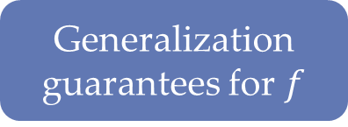
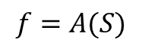
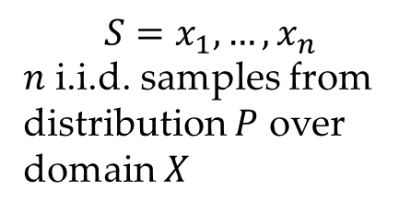
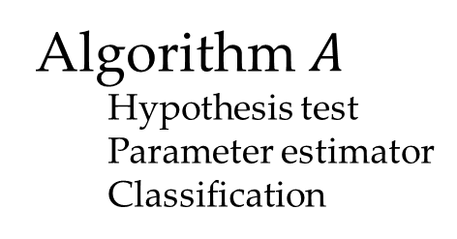
Statistical inference: theory
Data
Data
Data
$$S=x_{1},…,x_{n}$$
$n$ i.i.d. samples from
distribution $P$ over domain $X$
Theory
Concentration/CLT
Uniform convergence
Online-to-batch
Algorithm$A$
Hypothesis test
Parameter estimator
Classification
Generalization
guarantees for $f$
$$f=A(S)$$

Slide 3



Data analysis is adaptive
Multiple steps each depending on the outcomes of previous ones on the same dataset
$$A_{1}$$
Hyper-parameter tuning
Trial-and-error
Feature selection
Exploratory data analysis
Shared datasets
…
$$v_{1}$$
$$A_{2}$$
$$v_{2}$$
$$A_{k}$$
$$v_{k}$$
$$S$$
Data analyst(s)
Notes:
Mention non-adaptive reuse

Slide 4

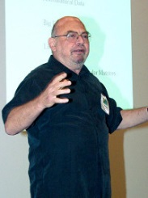
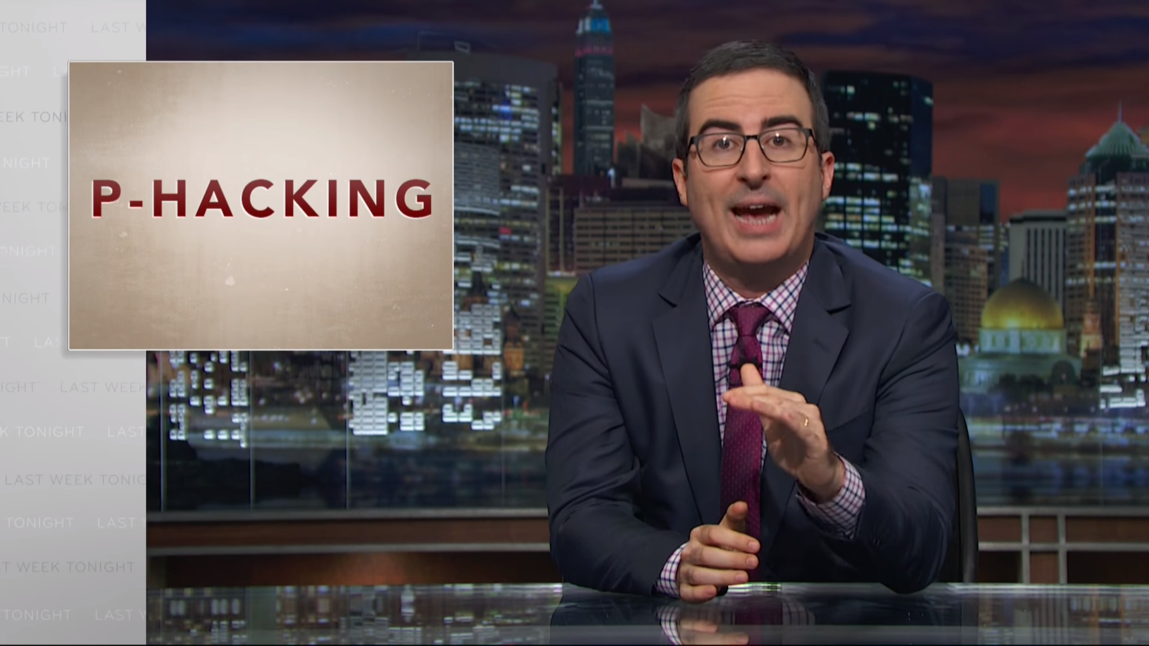
Thou shalt not test
hypotheses suggested
by data
“Quiet scandal of statistics”
[Leo Breiman, 1992]

Slide 5
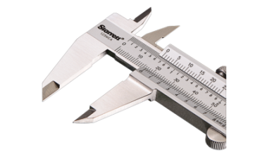
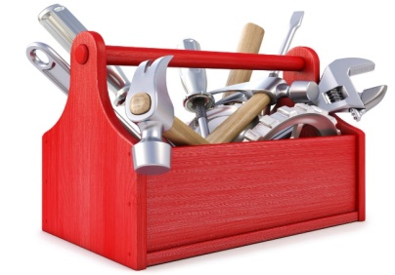
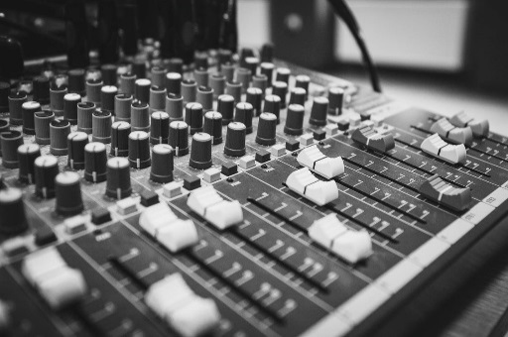
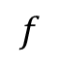
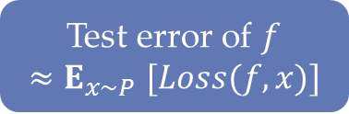
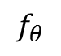
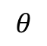
ML practice
Data
Data
Data
Data
Data
Data
Data
Training
Validation
Testing
$$θ$$
XGBoost SVRG Tensorflow
$$f$$
$$f_{θ}$$
Test error of $f$
$${≈E}_{x∼P}[Loss(f,x)]$$

Slide 6

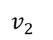
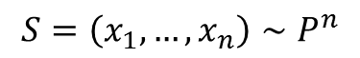
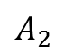
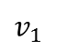
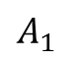
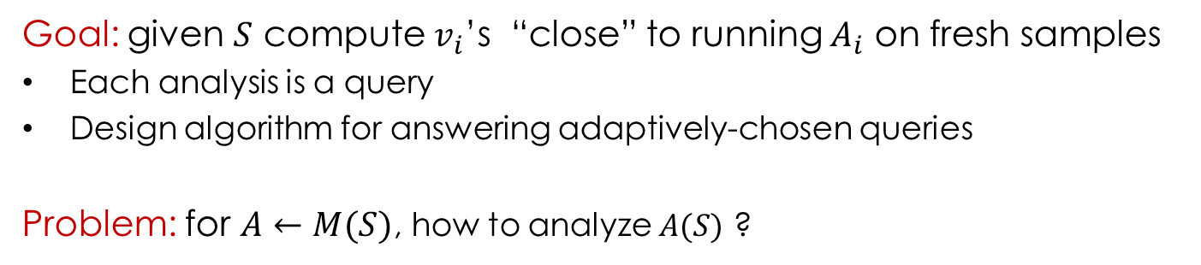
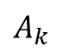
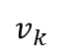
Adaptive data analysis [Dwork,F,Hardt,Pitassi,Reingold,Roth 14]
$$A_{1}$$
Algorithm
$$v_{1}$$
$$A_{2}$$
$$v_{2}$$
$$A_{k}$$
$$v_{k}$$
$$S=\left(x_{1},…,x_{n}\right)∼P^{n}$$
Data analyst(s)
Goal: given $S$ compute $v_{i}$’s “close” to running $A_{i}$ on fresh samples
Each analysis is a query
Design algorithm for answering adaptively-chosen queries
Problem: for $A←M(S)$, how to analyze $A(S)$ ?

Slide 7

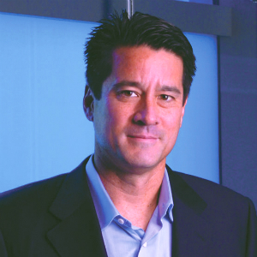
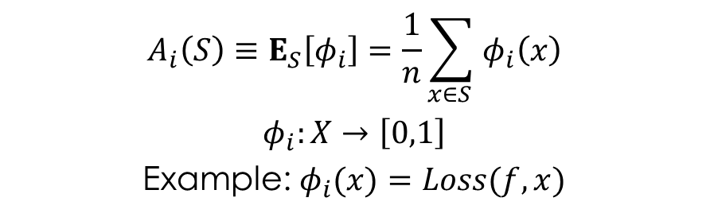
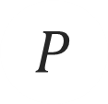
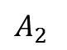
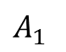
Adaptive statistical queries
$$A_{1}$$
$$v_{1}$$
$$A_{2}$$
$$v_{2}$$
$$P$$
$$A_{k}$$
$$v_{k}$$
Statistical query oracle
[Kearns ‘93]
Data analyst(s)
$$S=\left(x_{1},…,x_{n}\right)∼P^{n}$$
$$A_{i}\left(S\right)≡E_{S}\left[φ_{i}\right]=\frac{1}{n}\sum_{x∈S }{φ_{i}\left(x\right)}$$
$φ_{i}:X→\left[0,1\right]$
Example: $φ_{i}(x)=Loss(f,x)$
For “fresh” $S,$ $E_{S}\left[φ_{i}\right]≈E_{x∼P}\left[φ_{i}\left(x\right)\right]$
Goal: minimize$\max_{i}\left|v_{i}−E_{x∼P}\left[φ_{i}\left(x\right)\right]\right|=τ$

Slide 8
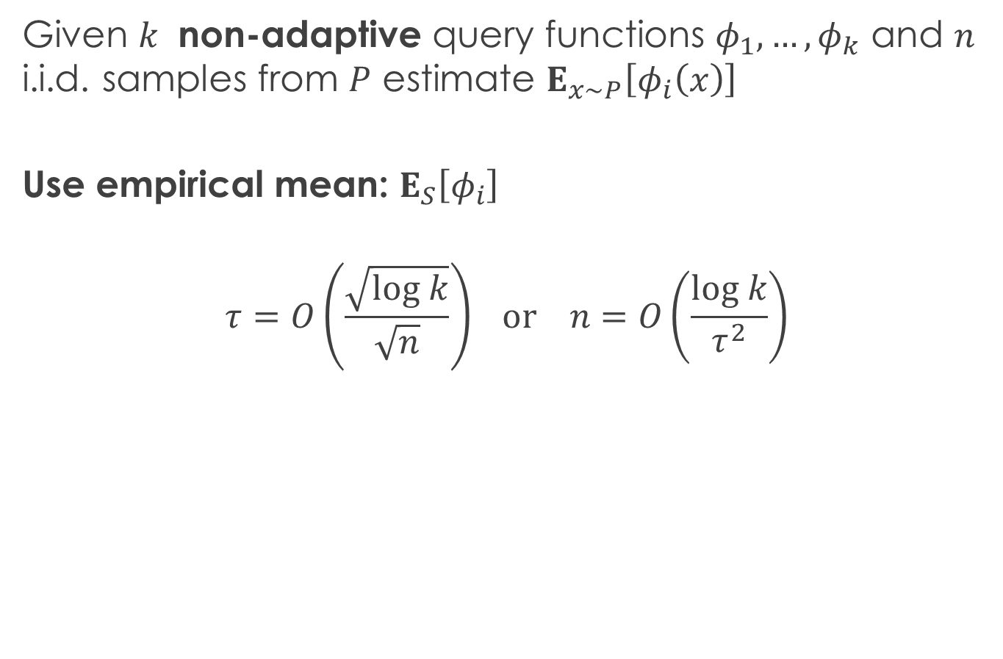
Answering non-adaptive SQs
Given $k$ non-adaptive query functions $φ_{1},…{,φ}_{k}$ and $n$ i.i.d. samples from $P$ estimate $E_{x∼P}\left[φ_{i}\left(x\right)\right]$
Use empirical mean: $E_{S}\left[φ_{i}\right]$
$$τ=O\left(\frac{\sqrt{log k}}{\sqrt{n}}\right) or n=O\left(\frac{log k}{τ^{2}}\right)$$

Slide 9


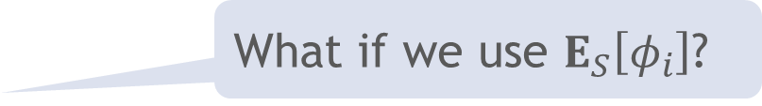
Answering adaptively-chosen SQs
What if we use $E_{S}\left[φ_{i}\right]$?
With some constant probability $β>0:$
$$τ≥\frac{\sqrt{k}}{\sqrt{n}} or n≥\frac{k}{τ^{2}}$$
Data splitting: $τ=O\left(\frac{\sqrt{k\log{k}}}{\sqrt{n}}\right)$

Slide 10
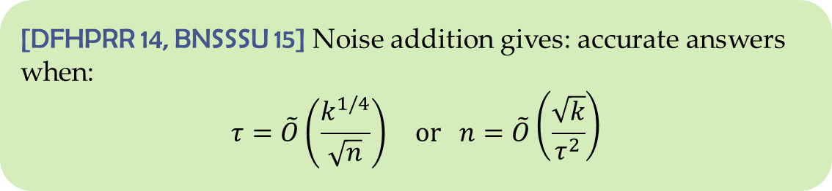

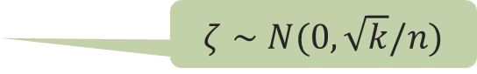
Perturbation
Noise addition:
Answer a query $φ$ with $E_{S}[φ]+ζ$
$ζ∼$ $N(0,\sqrt{k}/n)$
[DFHPRR 14, BNSSSU 15] Noise addition gives: accurate answers when:
$$τ=\tilde{O}\left(\frac{k^{1/4}}{\sqrt{n}}\right) or n=\tilde{O}\left(\frac{\sqrt{k}}{τ^{2}}\right)$$
Nearly optimal: $n=Ω(\sqrt{k}/τ)$ samples are necessary
[Hardt,Ullman ‘14; Steinke,Ullman ‘15]

Slide 11

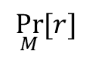
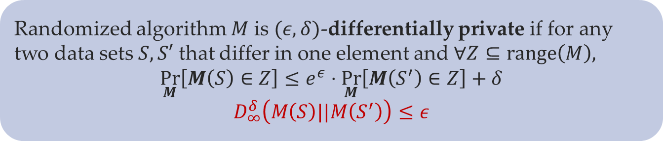

Differential privacy [Dwork,McSherry,Nissim,Smith 06]
$$S$$
$$S′$$
M
ratio bounded
$$\underset{M}{Pr}{[r]}$$
Randomized algorithm $M$ is $(ε,δ)$-differentially private if for any two data sets $S,S′$ that differ in one element and $∀Z⊆range\left(M\right),$
$$\underset{M}{Pr}\left[M\left(S\right)∈Z\right]≤e^{ε}⋅\underset{M}{Pr}\left[M\left(S^{′}\right)∈Z\right]+δ$$
$$D_{∞}^{δ}\left(M\left(S\right)||M\left(S^{′}\right)\right)≤ε$$

Slide 12

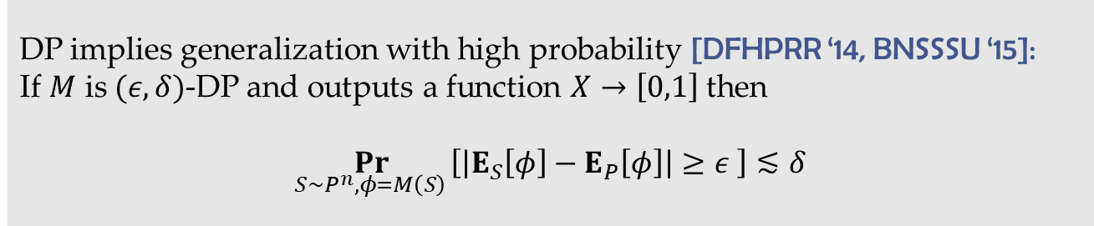
DP implies generalization
Similar to uniform replace-one stability [Bousquet,Elisseeff ‘02]
Differential privacy is output distribution stability: $D_{∞}^{δ}\left(M\left(S\right)||M\left(S^{′}\right)\right)≤ε$
DP implies generalization with high probability [DFHPRR ‘14, BNSSSU ‘15]:
If $M$ is $(ε,δ)$-DP and outputs a function $X→\left[0,1\right]$ then
$$\underset{S∼P^{n}, φ=M\left(S\right) }{Pr}\left[\left|E_{S}\left[φ\right]−E_{P}\left[φ\right]\right|≥ε \right]≲δ$$

Slide 13
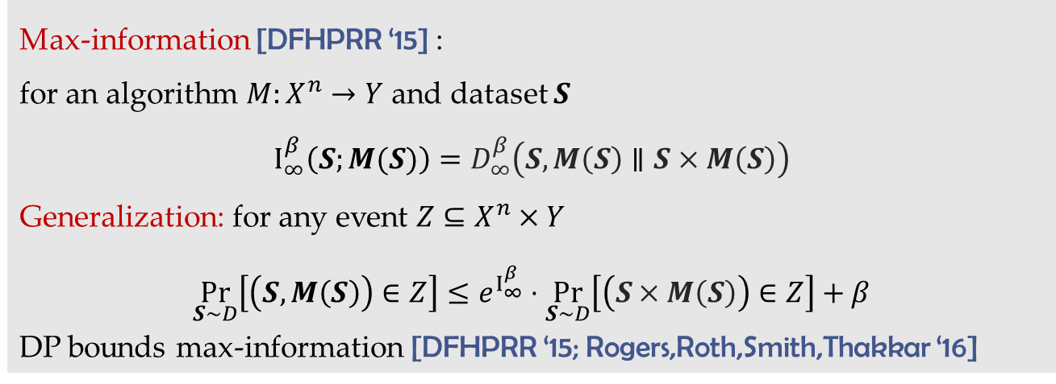
DP implies generalization
Differential privacy limits information learned about the dataset
Max-information [DFHPRR ‘15] :
for an algorithm $M:X^{n}→Y$ and dataset $S$
$$I_{∞}^{β}\left(S;M(S)\right)=D_{∞}^{β}\left(S,M\left(S\right)∥S×M\left(S\right)\right)$$
Generalization: for any event $Z⊆X^{n}×Y$
$$\underset{S∼D}{Pr}\left[\left(S,M\left(S\right)\right)∈Z\right]≤e^{I_{∞}^{β}}⋅\underset{S∼D}{Pr}\left[\left(S×M\left(S\right)\right)∈Z\right]+β$$
DP bounds max-information [DFHPRR ‘15; Rogers,Roth,Smith,Thakkar ‘16]

Slide 14

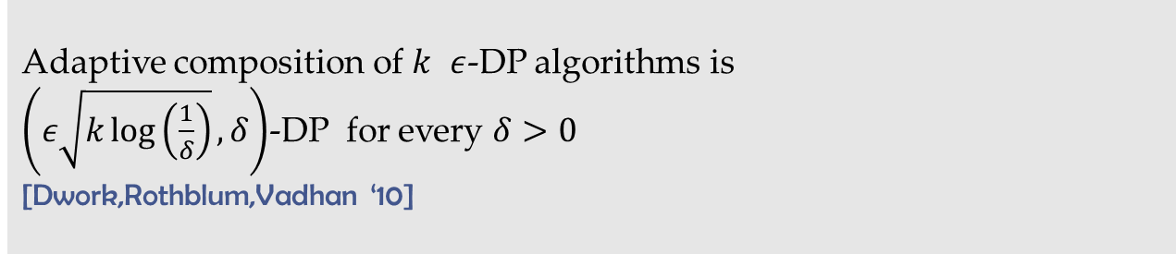
DP implies generalization
DP composes adaptively
Adaptive composition of $k$ $ε$-DP algorithms is
$\left(ε\sqrt{k\log\left(\frac{1}{δ}\right)},δ\right)$-DP for every $δ>0$
[Dwork,Rothblum,Vadhan ‘10]

Slide 15
DP implies generalization
DP composes adaptively
If $M$ is
“accurate” when fresh samples are used to answer a query
differentially private
Then $M$ is “accurate” when same dataset is reused for adaptively-chosen queries

Slide 16
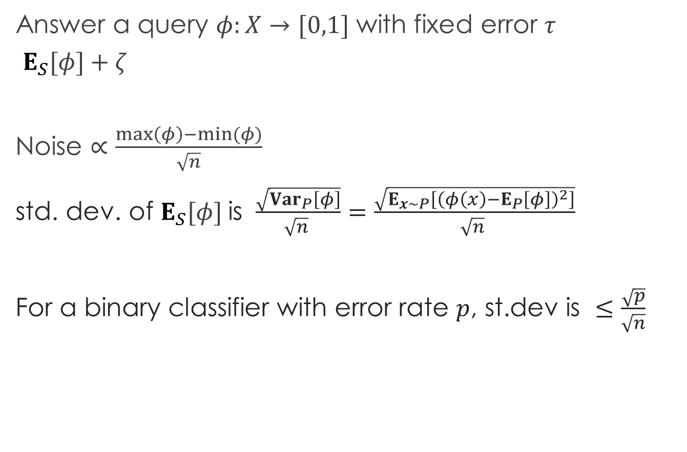
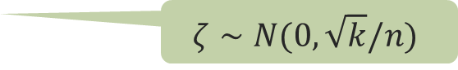
Limitations
Answer a query $φ:X→[0,1]$ with fixed error $τ$
$E_{S}[φ]+ζ$
Noise $∝\frac{\max\left(φ\right)−min⁡(φ)}{\sqrt{n}}$
std. dev. of $E_{S}[φ]$ is $\frac{\sqrt{{Var}_{P}\left[φ\right]}}{{\sqrt{n}}^{ }}=\frac{\sqrt{E_{x∼P}\left[{\left(φ\left(x\right)−E_{P}\left[φ\right]\right)}^{2}\right]}}{{\sqrt{n}}^{ }}$
For a binary classifier with error rate $p$, st.dev is $≤\frac{\sqrt{p}}{\sqrt{n}}$
$$ζ∼N(0,\sqrt{k}/n)$$

Slide 17
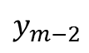
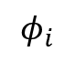
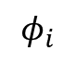
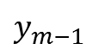
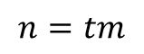
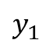
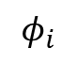
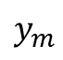
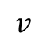
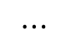
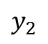
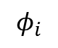







Stable median of means [F.,Steinke ‘17]
$$S$$
$$S^{1}$$ | $S^{2}$ | $$S^{3}$$ | $⋯$ | $$⋯$$ | $$⋯$$ | $$S^{m}$$
$$n=tm$$
$⋯$
$$φ_{i}$$
$$φ_{i}$$
$$φ_{i}$$
$⋯$
$$φ_{i}$$
$$φ_{i}$$
$$φ_{i}$$
$$y_{1}$$
$$y_{2}$$
$$y_{3}$$
$$y_{m−2}$$
$$y_{m−1}$$
$$y_{m}$$
$$U$$
$$v$$
Find an approximate median with diff.privacy relative to $U$
value $v$ greater than bottom 1/3 and smaller than top 1/3 in $U$

Slide 18




Median algorithms
Requires discretization: ground set $T$, $|T|=r$
Upper bound: $2^{O(\log^{∗}r)}$ samples
Lower bound: $Ω(\log^{∗}r)$ samples
[Bun,Nissim,Stemmer,Vadhan ‘15]
$$U$$
$$T$$
Exponential mechanism [McSherry,Talwar ‘07]
Output $v∈T$ with prob. $∝e^{−ε \left|\underset{y∈U}{\#}\left[v≤y\right]−\frac{m}{2}\right|}$
Uses $O\left(\frac{log r}{ε}\right)$ samples

Slide 19

Beyond worst-case sensitivity
[F, Steinke ‘17] For any adaptively-chosen sequence $φ_{1},…,φ_{k}:X→ℝ$ given $n$ i.i.d. samples from $P$,
Stable-Median outputs values $v_{1},…,v_{k}$ such that w.h.p. for all $i$:
$$\left|E_{P}\left[φ_{i}\right]−v_{i}\right|≤O\left(\frac{k^{1/4}\sqrt{{Var}_{x∼P}\left[φ_{i}\left(x\right)\right]}}{{\sqrt{n}}^{ }}\right)$$

Slide 20


Calibrating noise to variance
Can the noise be scaled to the standard deviation of $E_{S}\left[φ\right]$
to get error scaling as $\frac{\sqrt{{Var}_{P}\left[φ\right]}}{{\sqrt{n}}^{ }}$
Given: $φ:X→ℝ$
$\hat{μ}≐\frac{1}{n}\sum{φ(x_{i})}$
${\hat{σ}}^{2}≐\frac{1}{n}\sum{{\left(φ\left(x_{i}\right)−\hat{μ}\right)}^{2}}$
Output: $\hat{μ}+N\left(0,\frac{{\hat{σ}}^{2}}{n}\right)$
Notes:
Several works trying to do that but no improvement or

Slide 21


Beyond differential privacy
[F, Steinke 18] Average leave-one-out KL stability:
$M$ is $γ$-ALKL stable if
$$\frac{1}{n}\sum_{i∈[n]}{D_{KL}\left(M\left(S\right)∥M\left(S^{\backslash i}\right)\right)}≤γ$$
Backward compatible:
$ε$-DP implies $≈ε^{2}$-ALKL stable
also for most $\left(ε,δ\right)$-DP algorithms
Composes adaptively:
composition of $k$ $γ$-stable algorithms is $kγ$-stable

Slide 22



Stability$→$information
If $M$ is $γ$-ALKL stable then for $S∼P^{n}$,
$$I\left(M\left(S\right);S\right)≤γn$$
Mutual information stability:
$M$ is $γ$-MI stable if for any $S∼D$ over $X^{n}$
$$\frac{1}{n}\sum_{i∈[n]}{I\left(M\left(S\right);S_{i} | S^{\backslash i}\right)}≤γ$$

Slide 23



Information$→$generalization
Mutual information implies generalization in expectation
scaled by standard deviation:
$$\left|\underset{S∼P^{n}, φ=M\left(S\right) }{E}\left[\frac{E_{S}\left[φ\right]−E_{P}\left[φ\right]}{\sqrt{{Var}_{P}\left[φ\right]}}\right]\right|≲\sqrt{\frac{I\left(M\left(S\right);S\right)}{n}}=\sqrt{γ}$$
based on [Russo,Zou 16]
$I\left(M\left(S\right);S\right)=D_{KL}(S,M\left(S\right)∥S×M\left(S\right))$
For real valued r.v.’s $X,Y$ and $t>0,$
$$E\left[X\right]≤\frac{1}{t} \left(D_{KL}\left(X∥Y\right)+E\left[e^{tY}\right]\right)$$

Slide 24



Calibrating noise to variance
Given: $φ:X→[0,1]$
$\hat{μ}≐\frac{1}{n}\sum{φ(x_{i})}$
${\hat{σ}}^{2}≐\frac{1}{n}\sum{{\left(φ\left(x_{i}\right)−\hat{μ}\right)}^{2}}$
Output: $\hat{μ}+N\left(0,1\right)⋅\max\left\{\frac{1}{n},\frac{\hat{σ}}{\sqrt{n}}\right\}$
$\frac{1}{n}$-ALKL stable
[F, Steinke 18] For any adaptively-chosen sequence $φ_{1},…,φ_{k}:X→[0,1]$ given $n$ i.i.d. samples from $P$ the noisy estimates $v_{1},…,v_{k}$ satisfy:
$$\underset{S∼P^{n}, \overline{φ},\overline{v}}{E}\left[\max_{i}{\frac{\left|v_{i}−E_{P}\left[φ_{i}\right]\right|}{σ_{i}^{+}}}\right]=\tilde{O}(1)$$
where $σ_{i}^{+}=\max\left\{\sqrt{\frac{\sqrt{k}{ Var}_{P}\left[φ_{i}\right]}{n}},\frac{\sqrt{k}}{n}\right\}$
Notes:
Several works trying to do that but no improvement or

Slide 25
















Everlasting database [Woodworth,F.,Rosset,Srebro 18]
$$1\$$$
$$φ_{1}$$
Algorithm
$$v_{1},\$p_{1}$$
$$x_{n+1}∼P$$
$$φ_{2}$$
$$v_{2},\$p_{2}$$
$$x_{n+2}∼P$$
$$S∼P^{n}$$
$$P$$
Users
Algorithm for answering and pricing queries
Allows adaptive queries
Guarantees statistically valid estimates forever
Does not need to know which queries are adaptive or their number
Users asking $m$ non-adaptive queries pay on average $\frac{\log{m}}{m}$ per query
Users with adaptive queries pay on average $\frac{1}{\sqrt{m}}$ per query

Slide 26
Conclusions
Statistical validity is a limited resource
Framework for modeling adaptivity
Beyond worst-case adaptivity?
Diff. privacy is useful but might be an overkill
ALKL stability
Similar properties but less restrictive than DP
Easier to analyze
How to get generalization with high-probability?
Using these techniques in practice
Bad constants/log factors
Involved proofs
Pessimistic assumptions

